Slide 1

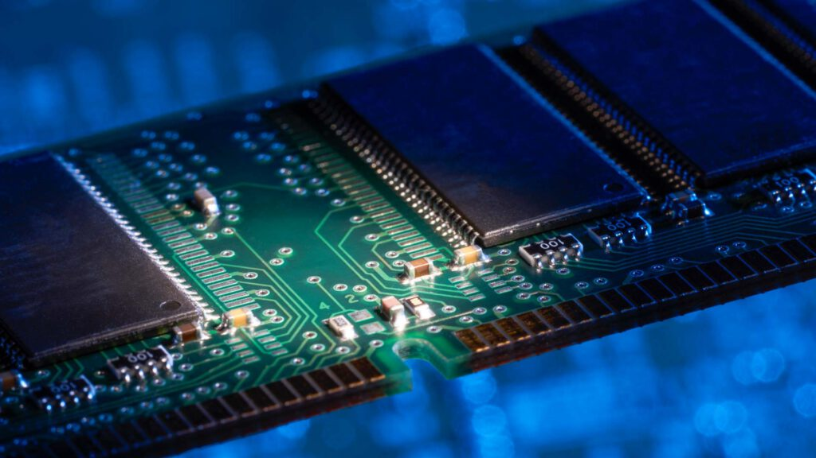
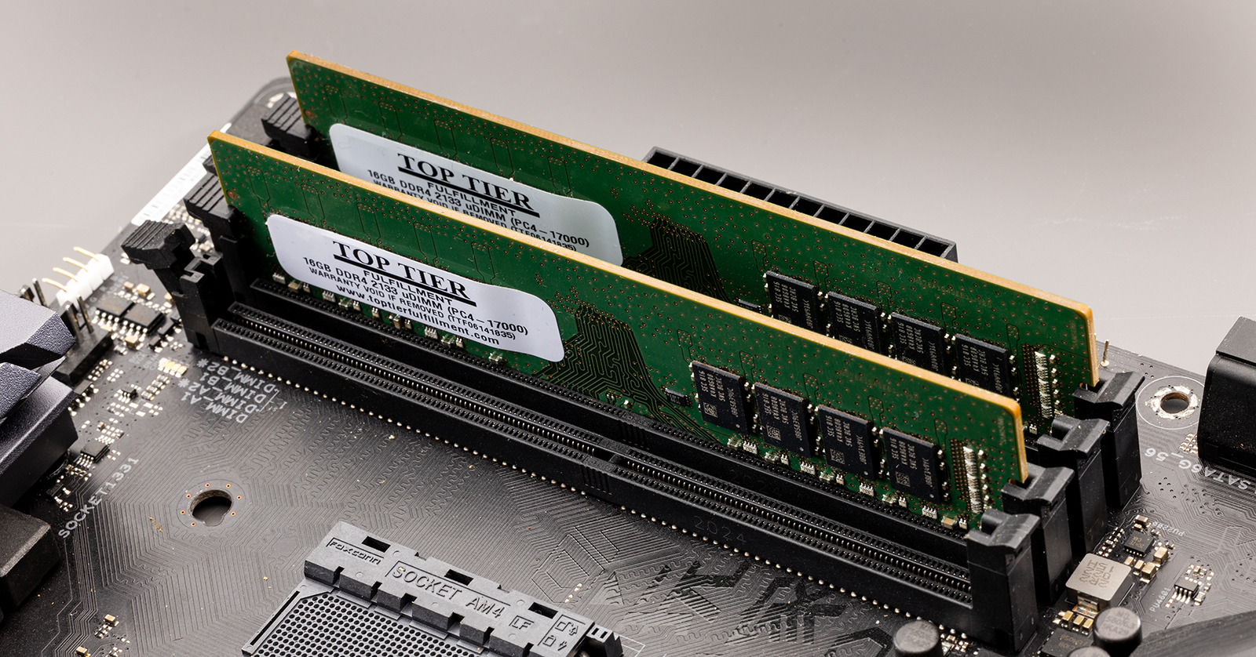
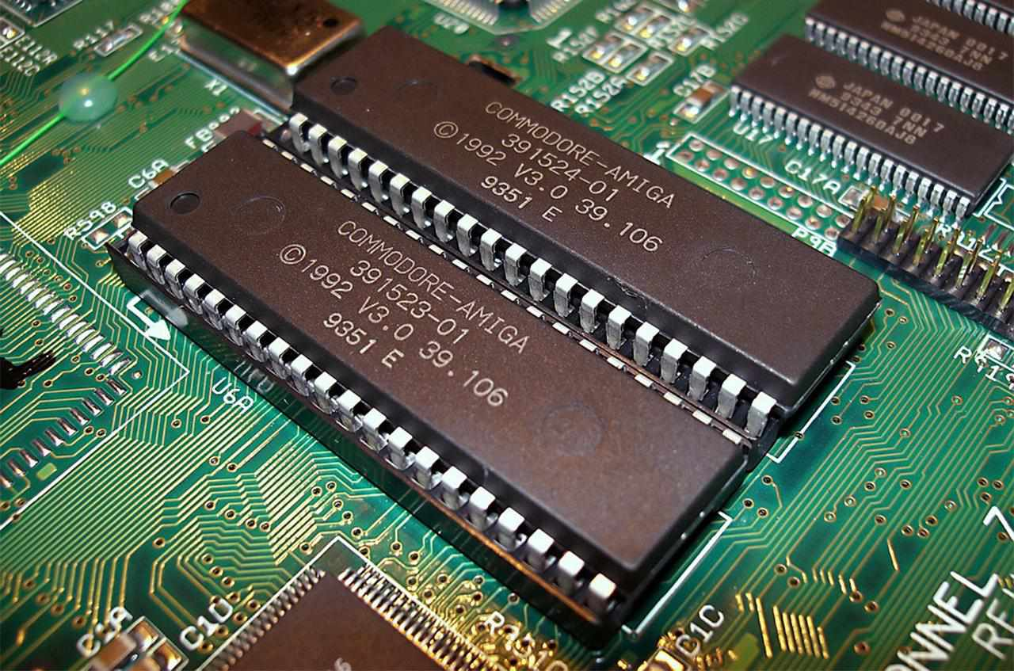
Department of Computer Science and Engineering, BRAC University
Lecture 10
Register Basics and Memory Unit
CSE260 : Digital Logic Design

Slide 2
Registers
Flip-flops can only store 1-bit of data
Multiple flip-flops can be combined into a single group which is called a register
A register can store multiple bits
An n-bit register is consist of n flip-flops and different logic gates, it can store n-bit information
The flip-flops in a register store information
The logic gates and other components control the insertion and the flow of the data
Functions of register
Storing data
Retrieving data from other registers
Shifting data within the register (right/left)
‹#›
Department of Computer Science and Engineering
CSE260 - Digital Logic Design

Slide 3
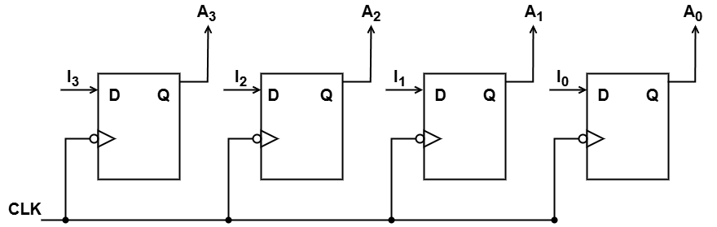
Simple Register
Example: A simple 4-bit register, consist of D flip-flops which does not contain any logic gate or other components. New 4-bit data is stored with every clock cycle.
‹#›
Department of Computer Science and Engineering
CSE260 - Digital Logic Design

Slide 4
What is Memory Unit?
A memory unit is a collection of registers together with associated circuits needed to transfer information in and out of registers.
Binary cell: An elementary unit of computer storage (i.e. memory register) that can have one or the other of two stable states and can thus store one bit of information.
The memory cell is an electronic circuit that stores one bit of binary information and it must be set to store a logic 1 (high voltage level) and reset to store a logic 0 (low voltage level). Its value is maintained/stored until it is changed by the set/reset process.
‹#›
Department of Computer Science and Engineering
CSE260 - Digital Logic Design

Slide 5
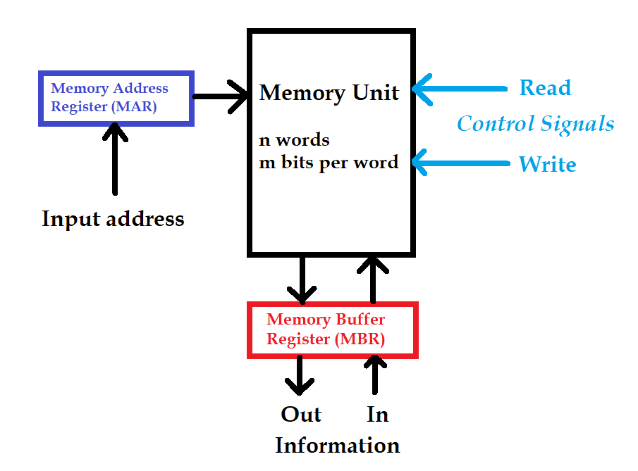
What is Memory Unit?
A memory unit stores binary information in groups of bits called words.
Communication between memory unit and its environment is achieved through 2 controls(read and write) and 2 external registers (memory address register and memory buffer register).
‹#›
Department of Computer Science and Engineering
CSE260 - Digital Logic Design

Slide 6
What is Memory Unit?
To communicate with a memory word, its address is transferred to memory address register. Internal circuit then opens the path to select that word. A n-bit address register can specify up to 2^{n} address. (note: # of address=# of word)
Before writing and after reading information are kept in Memory Buffer register. In each case, the address register specifies location of writing or reading.
‹#›
Department of Computer Science and Engineering
CSE260 - Digital Logic Design

Slide 7
READ Operation Example
Memory Unit
0 | 0101 0101
1 | 0000 0000
… | …
41 | 0011 0011
42 | 0110 1110
… | …
255 | 0000 0000
MAR
0010 1010
Read = 1
Write = 0
Input Address = 42
MBR
0110 1110
‹#›
Department of Computer Science and Engineering
CSE260 - Digital Logic Design

Slide 8
WRITE Operation Example
Memory Unit
0 | 0101 0101
1 | 0000 0000
… | …
41 | 0011 0011
42 | 1001 0010
… | …
255 | 0000 0000
MAR
0010 1010
Read = 0
Write = 1
Input Address = 42
MBR
1001 0010
‹#›
Department of Computer Science and Engineering
CSE260 - Digital Logic Design

Slide 9
Content of a Memory
Content of a 1024 x 16-bit memory:
Memory address
binary
decimal
Memory content
0000000000
0000000001
0000000010
:
:
1111111101
1111111110
1111111111
0
1
2
:
:
1021
1022
1023
1011010111011101
1010000110000110
0010011101110001
:
:
1110010101010010
0011111010101110
1011000110010101
‹#›
Department of Computer Science and Engineering
CSE260 - Digital Logic Design

Slide 10
Types of Semiconductor Memories
ROM – Read Only Memory - a type of memory that cannot be written, can only be read. Contents determined during the manufacture time
RAM – Random Access Memory
Memory that can be both read and written during normal operation.
◆ Contents are volatile, i.e.will be lost on power off.
◆ Two types of RAM:
Static RAM (SRAM)
Dynamic RAM (DRAM)
‹#›
Department of Computer Science and Engineering
CSE260 - Digital Logic Design

Slide 11
Random Access Memory (RAM)
The data consists of n lines (for n-bit words). Data input lines provide the information to be stored (written) into the memory, while data output lines carry the information out (read) from the memory.
The address consists of k lines which specify which word (among the 2^{k} words available) to be selected for reading or writing.
‹#›
Department of Computer Science and Engineering
CSE260 - Digital Logic Design

Slide 12
Random Access Memory (RAM)
The control lines Read and Write (usually combined into a single control line Read/Write) specifies the direction of transfer of the data.
Example: A memory unit of 1024 words with 8 bit/word needs, 10 address line (i.e. address register must contain 10 FF) and buffer register must have 8 FF to store words transferred in and out of it.
‹#›
Department of Computer Science and Engineering
CSE260 - Digital Logic Design

Slide 13
Random Access Memory (RAM)
Block diagram of a memory unit:
n data input lines
n
k
k address lines
Memory unit
2^{k} words
n bits per word
Read/Write
n
n data output lines
‹#›
Department of Computer Science and Engineering
CSE260 - Digital Logic Design

Slide 14
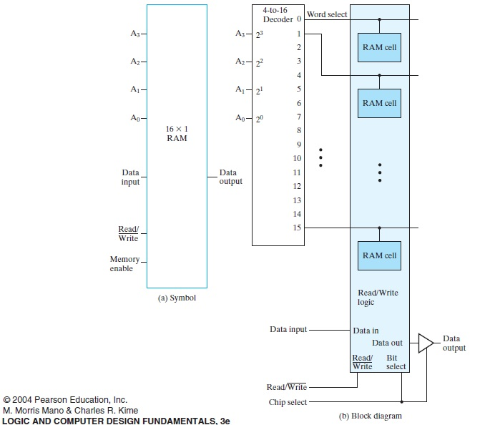
Block
Diagram
of
16x1
RAM [no need to memorize]
‹#›
Department of Computer Science and Engineering
CSE260 - Digital Logic Design

Slide 15
Random Access Memory (RAM)
The Write operation:
Transfers the address of the desired word to the address lines
Transfers the data bits (the word) to be stored in memory to the data input lines
Activates the Write control line (set Read/Write to 0)
The Read operation:
Transfers the address of the desired word to the address lines
Activates the Read control line (set Read/Write to 1)
‹#›
Department of Computer Science and Engineering
CSE260 - Digital Logic Design

Slide 16
Random Access Memory (RAM)
The Read/Write operation:
Memory Enable | Read/Write | Memory Operation
0 | X | None
1 | 0 | Write to selected word
1 | 1 | Read from selected word
‹#›
Department of Computer Science and Engineering
CSE260 - Digital Logic Design

Slide 17
Two types of RAM
Static RAM (SRAM):
Uses flip-flops as the memory cells, Complex Circuitry.
No need to refresh constantly
Typically the type of RAM used primarily as cache memory.
Dynamic RAM (DRAM):
Use capacitor charges to represent datas.
Though simpler in circuitry, they have to be constantly refreshed.
Most main memory is dynamic RAM
‹#›
Department of Computer Science and Engineering
CSE260 - Digital Logic Design

Slide 18
Two types of RAM [Cont.]
Dynamic RAM:
SDRAM – Synchronous dynamic RAM – operates synchronously with system clock and data bus. Can handle 100MHz to >800MHz.
DDR – Double Data Rate – can transmit data on both edges of the clock. DDR3 = Double Data Rate 3rd generation.
QDR – Quad Data Rate – twice as fast as DDR
Typically we use DDR3, DDR4 & DDR5 RAM as main memory in our windows PC and Static RAM for L1, L2 and L3 cache memory.
‹#›
Department of Computer Science and Engineering
CSE260 - Digital Logic Design

Slide 19
Memory Size
Memory sizes might be specified in bits or byte(=8bit)
Symbol: Bytes (B) and bits(b)
Example,
2²⁸ b
= 2²⁸/8 B
= 2²⁸/2³ B
= 2²⁵ B
= 2⁵*2²⁰ B
= 32 MB
 | Prefix | Base 2 | Base 10
K | Kilo | 2¹⁰ = 1024 | 10³=1,000
M | Mega | 2²⁰ = 1,048,576 | 10⁶=1,000,000
G | Giga | 2³⁰ = 1,073,741,824 | 10⁹=1,000,000,000
1 Byte = 8 Bits 1 KB = 1024 Bytes 1 MB = 1024 KB 1 GB = 1024 MB 1 TB = 1024 GB 1 PB = 1024 TB 1 EB = 1024 PB
‹#›
Department of Computer Science and Engineering
CSE260 - Digital Logic Design

Slide 20
2 formulas to remember
Capacity = no. of word x bit/word
No. of word= 2 ^ (address lines)
Therefore,
Capacity = 2^(address lines) x bit/word
‹#›
Department of Computer Science and Engineering
CSE260 - Digital Logic Design

Slide 21
Test yourself
Capacity = no. of word x bit/word
No. of word= 2 ^ (address lines)
What is the total capacity of a 2¹⁶ x 16 memory?
‹#›
Department of Computer Science and Engineering
CSE260 - Digital Logic Design

Slide 22
Test yourself [Sol^{n}]
What is the total capacity of a 2¹⁶ x 16 memory:
Solution:
= 2^16 x 16 bits/words
= 1048576 bits
= 1048576/8 bytes
= 131072 bytes
= 131072/1024 KB
= 128 KB
‹#›
Department of Computer Science and Engineering
CSE260 - Digital Logic Design

Slide 23
Test yourself
Capacity = no. of word x bit/word
No. of word= 2 ^ (address lines)
How many address lines do we need for a 64 MB RAM with 32 bit words?
‹#›
Department of Computer Science and Engineering
CSE260 - Digital Logic Design

Slide 24
Test yourself [Sol^{n}]
How many address lines do we need for a 64 MB RAM with 32 bit words:
Solution:
Formula:
Capacity = no. of word x bit/word
64MB = no. of word x 32 bits/word
no. of word = 64MB / 32 bits/word
= (64x1024x1024x8)/32 [ 1 byte = 2^3 bits]
= 16777216
= 2^24 [log₂(16777216) = 24]
no. of address lines = 24
‹#›
Department of Computer Science and Engineering
CSE260 - Digital Logic Design

Slide 25
Binary cell
Must be small so that many binary cell (BC) can fit in a small area
Select input enable cell for reading/writing
Read/write determines operation to be performed on cell. A 1 in read/write input forms a path to the output terminal. A 0 in read/write input, information in the input terminal is transferred into the FF
Select (inputs)
Input
BC
Output
Read/Write
‹#›
Department of Computer Science and Engineering
CSE260 - Digital Logic Design

Slide 26
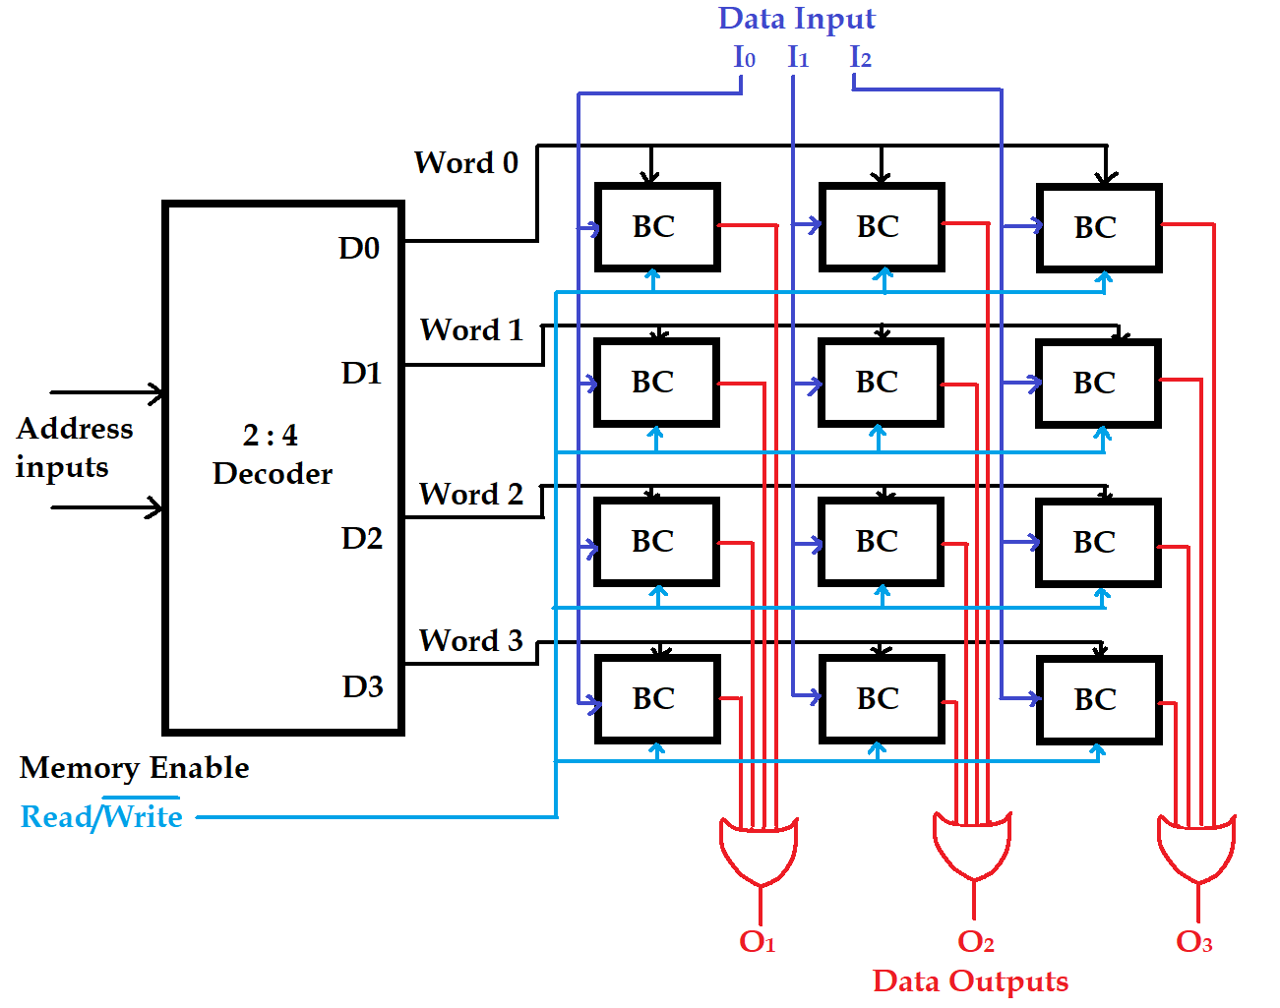
Random Access Memory (RAM)
# of word
Bit/word
Logic construction of a 4 x 3 RAM
(with decoder and OR gates):
Select (inputs)
Input
BC
Output
Read/Write
Since no of word is 4, that would be equivalent to the decoder’s output. Since, the decoder will have 4 outputs, so we should use a 2x4 decoder
‹#›
Department of Computer Science and Engineering
CSE260 - Digital Logic Design

Slide 27
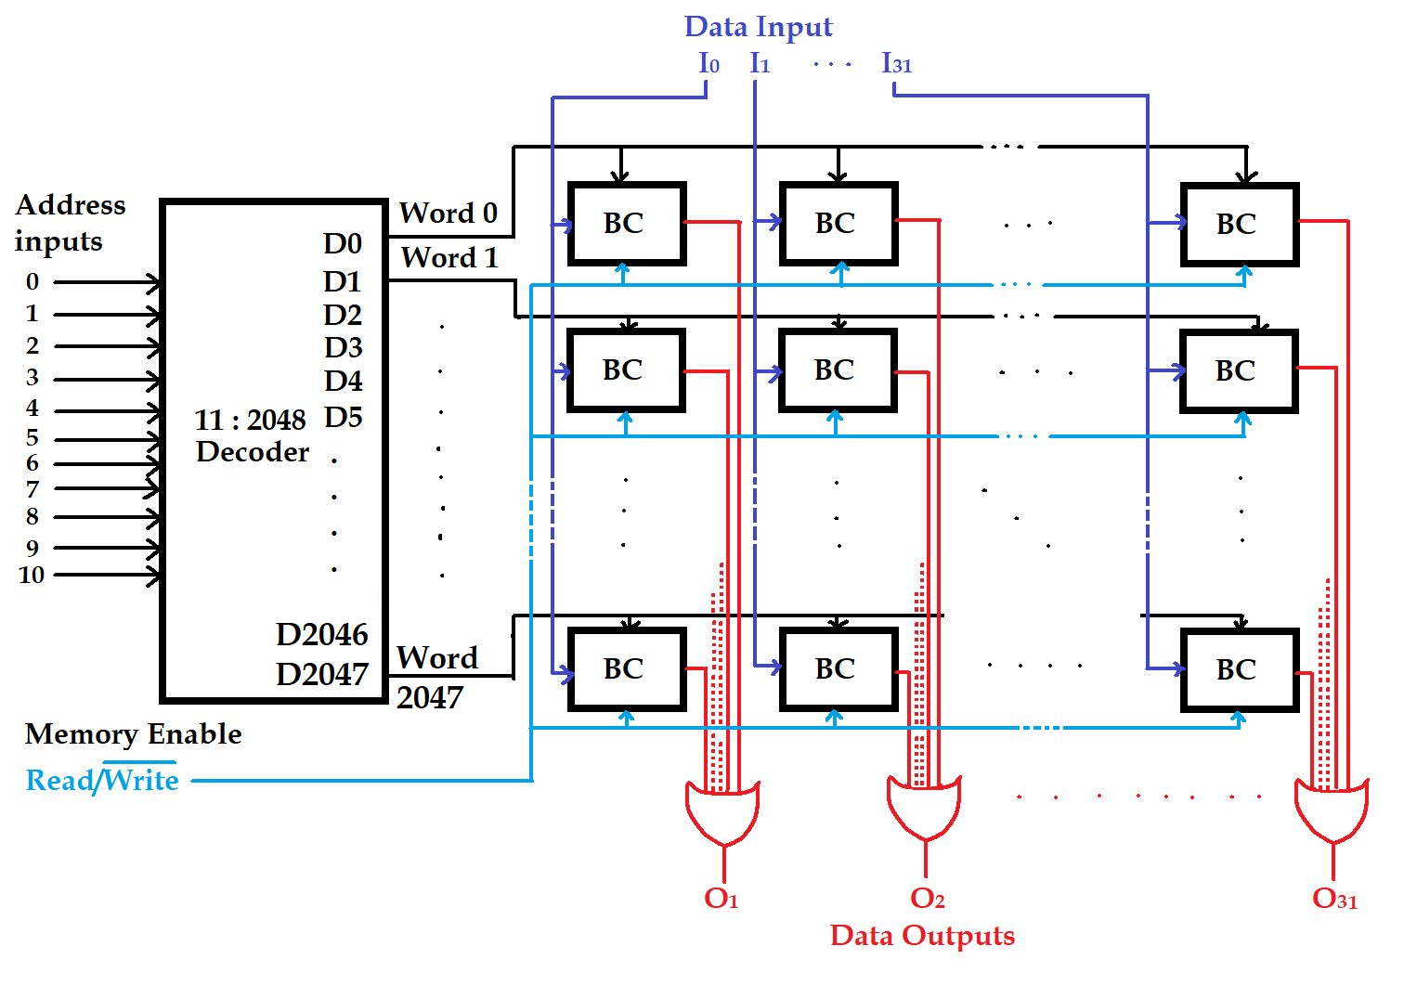
Random Access Memory (RAM)
# of word
Bit/word
Logic construction of a 2048 x 32 RAM
(with decoder and OR gates):
Select (inputs)
Input
BC
Output
Read/Write
Since no of word is 2048, that would be equivalent to the decoders output. Since, the decoder will have 2048 outputs, so we should use a 11x2048 decoder
‹#›
Department of Computer Science and Engineering
CSE260 - Digital Logic Design

Slide 28
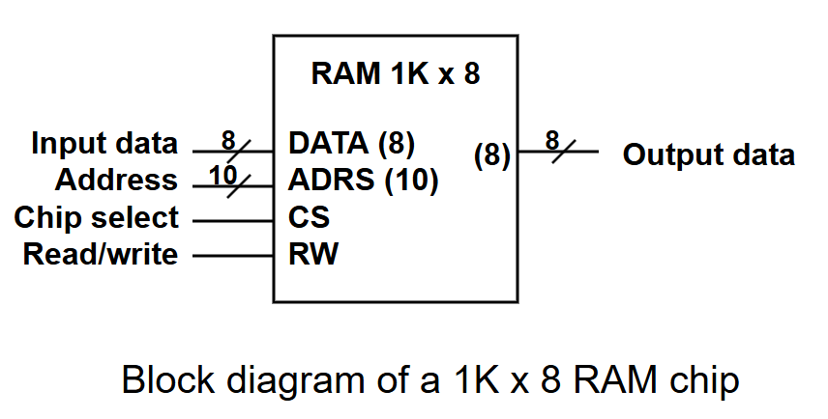
Random Access Memory (RAM)
An array of RAM chips: memory chips are combined to form larger memory.
A 1K x 8-bit RAM chip:
‹#›
Department of Computer Science and Engineering
CSE260 - Digital Logic Design

Slide 29
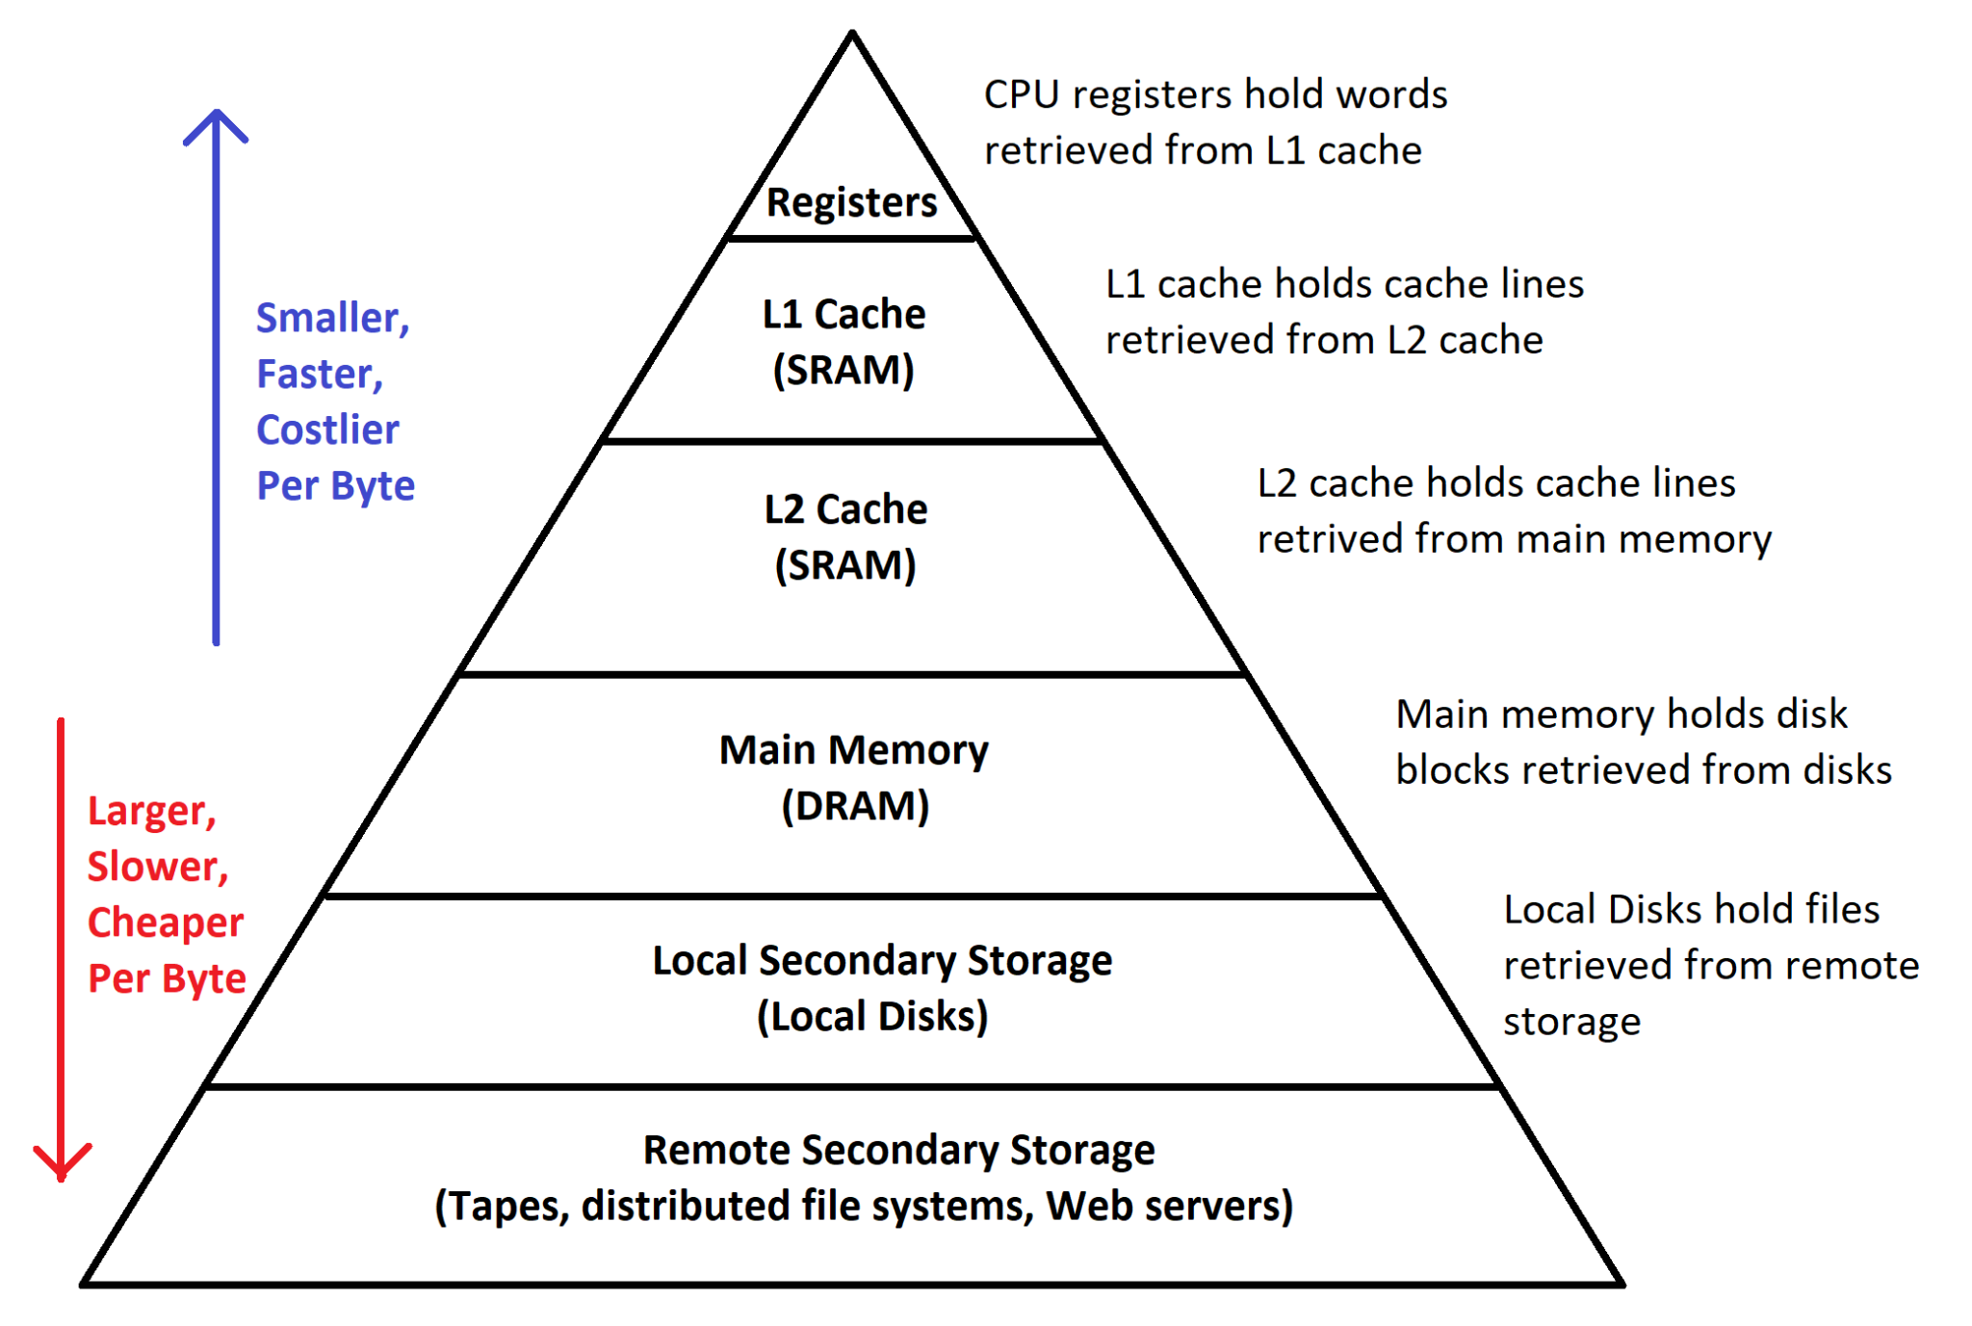
Hierarchy of Memory [Self Study-not important for CSE260 exam]
‹#›
Department of Computer Science and Engineering
CSE260 - Digital Logic Design

Slide 30
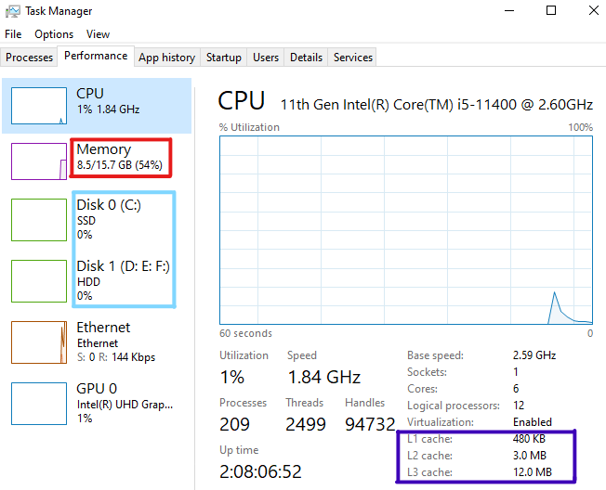
Check your PC’s RAM Specifications From
Task Manager (Windows) [Self Study-not important for CSE260 exam]
Main Memory:
Dynamic RAM
Local Secondary Storage
Cache Memory
Static RAM
‹#›
Department of Computer Science and Engineering
CSE260 - Digital Logic Design

